Slide 1
Programming Fundamental
Week 09
Sobia Iftikhar
Sobia.Iftikhar@nu.edu.pk

Slide 2
Class 22

Slide 3
We’ll Learn
Single & Multi-Dimensional Arrays
Passing arrays to a function
Sorting
Searching
Strings

Slide 4
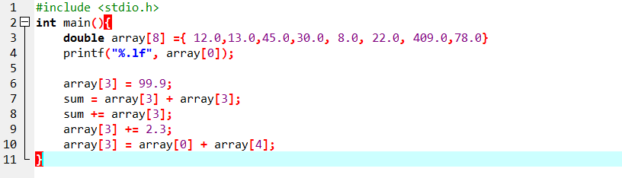
Statement that Manipulate Array
16.0 | 12.0 | 13.0 | 3.0 | 45.0 | 29.0 | 19.0 | 59.0
X[0] | X[1] | X[2] | X[3] | X[4] | X[5] | X[6] | X[7]

Slide 5
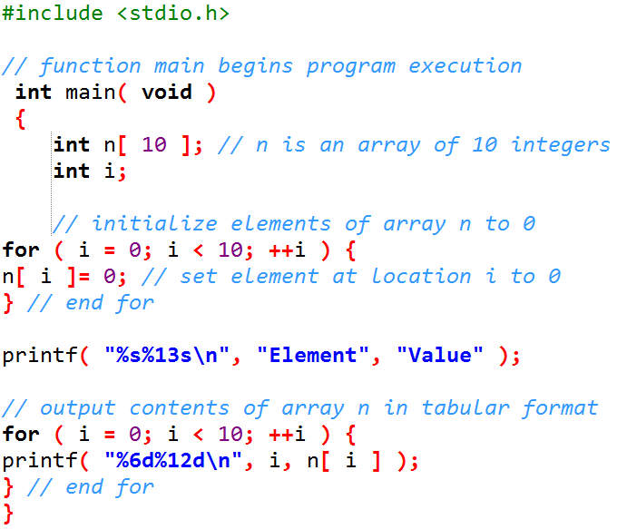
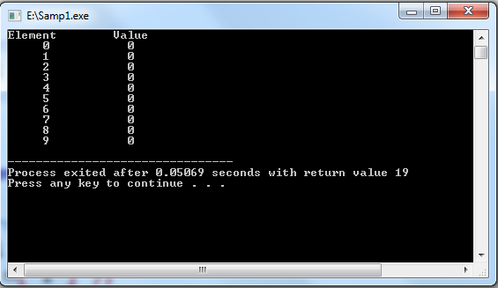
Arrays (Cont’d)

Slide 6
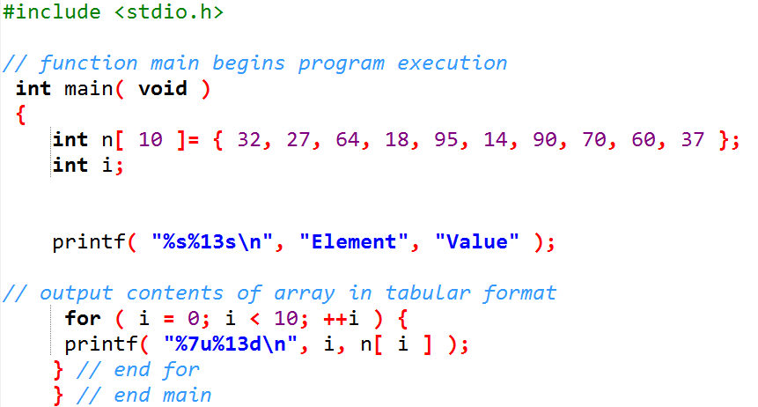
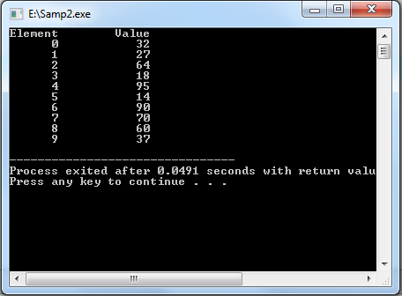
Arrays (Cont’d)

Slide 7

Using Character Arrays to Store and Manipulate Strings
We’ve discussed only integer arrays.
However, arrays are capable of holding data of any type.
We now discuss storing strings in character arrays. So far, the only string-processing.
A string such as "hello" is really an array of individual characters in C.
. Initializing a Character Array with a String

Slide 8
Initializing a Character Array with an Initializer List of Characters
Character arrays also can be initialized with individual character constants in an initializer list, but this can be tedious. The preceding definition is equivalent to

Slide 9
Arrays (Cont’d)
Characters Array or Strings
A string constant is a one-dimensional array of characters terminated by a null (‘\0’).
The terminator define end of string.
For example,
char name[5] = { ‘F’, ‘A’, ‘S’, ‘T’, ‘\0’ };
Input function scanf() can be used with %s format specifier to read a string input from the terminal. But there is one problem with scanf() function, it terminates its input on the first white space it encounters. Therefore if you try to read an input string "Hello World" using scanf() function, it will only read Hello and terminate after encountering white spaces.

Slide 10
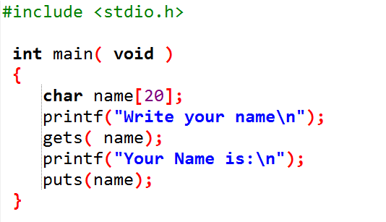
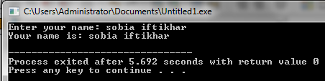
Arrays (Cont’d)
The String I/O Function gets() & puts()
Sanf() and printf() is not versatile for string I/O we can use gets() and puts() function from stdio library.
For Example:

Slide 11
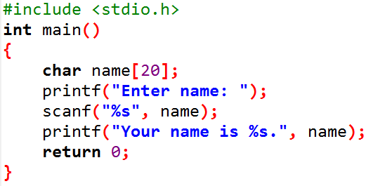
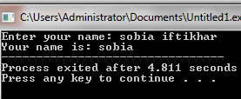
Example

Slide 12
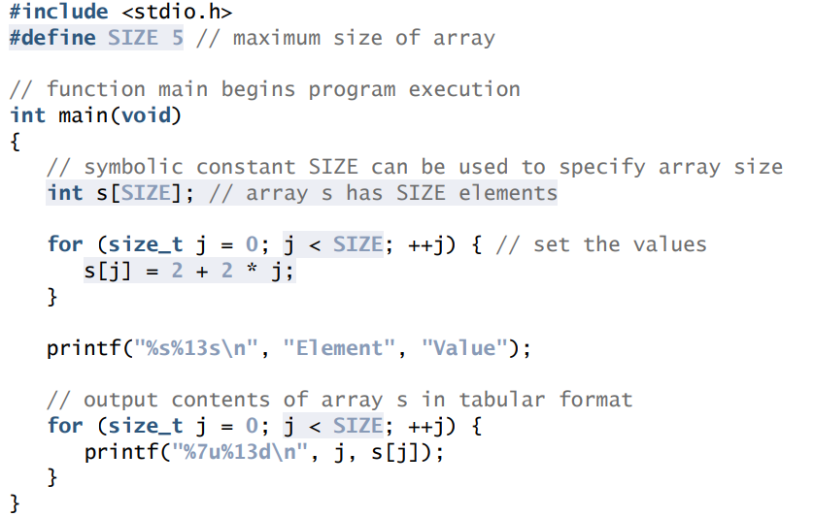
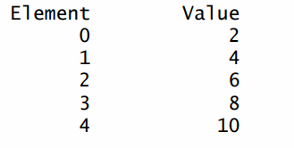
Example
5 initializes the elements of a five-element array s to the values 2, 4, 6, …, 10 and prints the array in tabular format

Slide 13
Class 23

Slide 14


Increment operator (++) −Array
It is used to increment the value of a variable by 1
There two types of increment operators − pre increment and post increment.
Increment operator is placed before the operand in preincrement and the value is first incremented and then operation is performed on it.

Slide 15

Example
Declare an array of size 5 and do compile time initialization. After that try to assign a pre incremented value to ‘a’ variable.

Slide 16
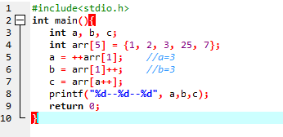
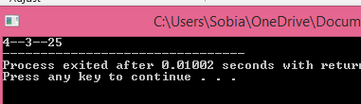
Example

Slide 17
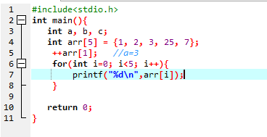
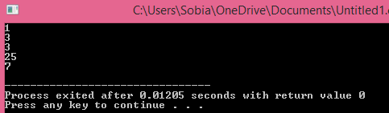
Example

Slide 18

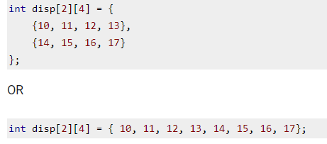
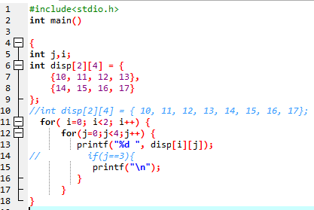
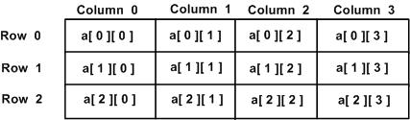

2D-Array
An array of arrays is known as 2D array. The two dimensional (2D) array in C programming is also known as matrix.
Initialization of 2D Array

Slide 19
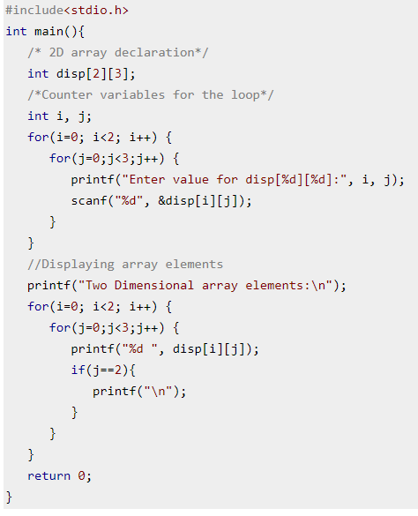
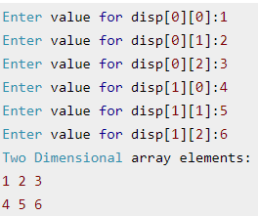
Example

Slide 20
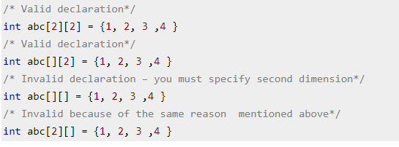
Important

Slide 21
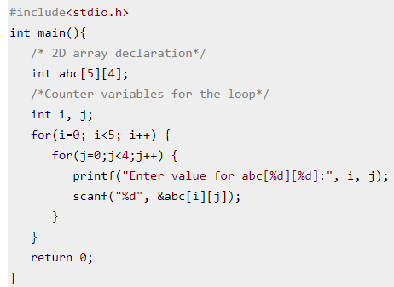
How to store user input data into 2D array

Slide 22
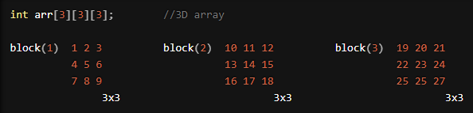
3-D Array
int arr[3][3][3], now it becomes a 3D array.
Int shows that the 3D array is an array of type integer.
arr is the name of array.
first dimension represents the block size(total number of 2D arrays).
second dimension represents the rows of 2D arrays.
third dimension represents the columns of 2D arrays. i.e; int arr[3][3][3], so the statement says that we want three such 2D arrays which consists of 3 rows and 3 columns.
A 3D array is a multi-dimensional array(array of arrays). A 3D array is a collection of 2D arrays. It is specified by using three subscripts: Block size, row size and column size.

Slide 23
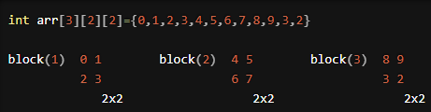
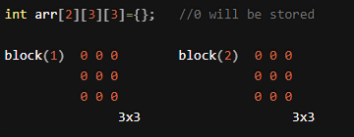
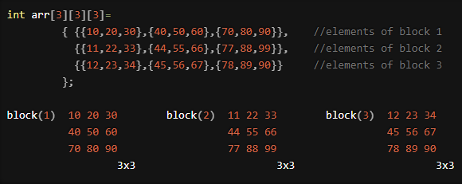
Ways to declare 3D array:

Slide 24
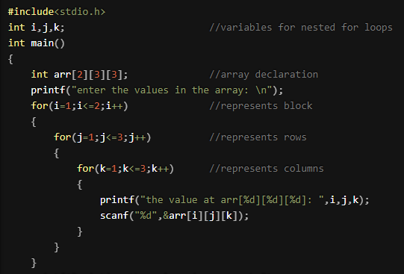
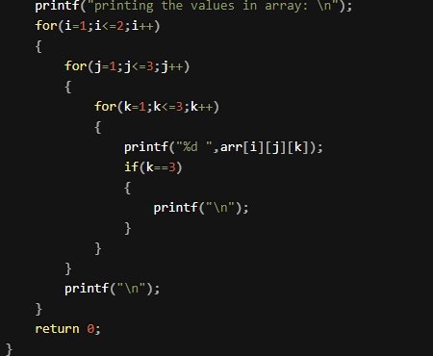
Inserting values in 3D array:

Slide 25
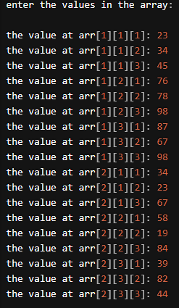
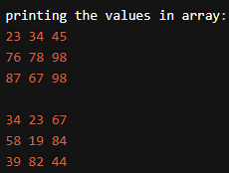

Slide 26
Class 24

Slide 27
Using Arrays to Summarize Survey Results
Forty students were asked to rate the quality of the food in the student cafeteria on a scale of 1 to 10 (1 means awful and 10 means excellent). Place the 40 responses in an integer array and summarize the results of the poll.

Slide 28
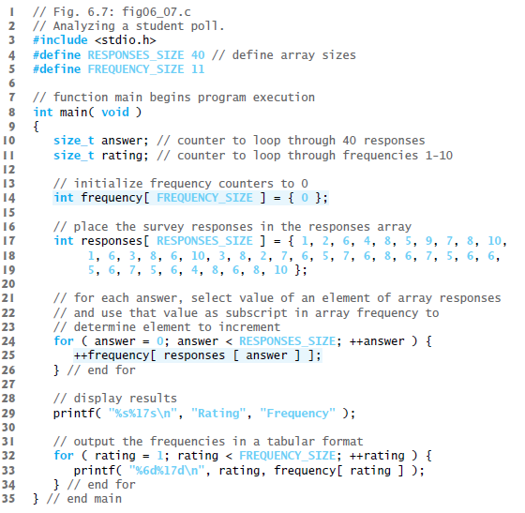

Slide 29
Sorting Array
Sorting data (i.e., placing the data into ascending or descending order) is one of the most important computing applications.
Telephone companies sort their lists of accounts by last name and, within that, by first name to make it easy to find phone numbers. Virtually every organization must sort some data, and in many cases massive amounts of it
A bank sorts all checks by account number so that it can prepare individual bank statements at the end of each month

Slide 30
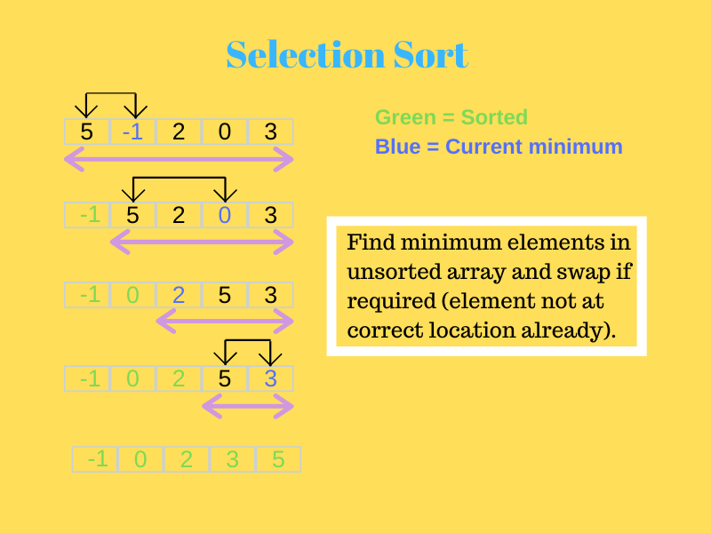

Slide 31
Example of Selection Sort
Consider the array:
[10,5,2,1]
The first element is 10. The next part we must find the smallest number from the remaining array. The smallest number from 5 2 and 1 is 1. So, we replace 10 by 1.
The new array is [1,5,2,10] Again, this process is repeated.
Finally, we get the sorted array as [1,2,5,10].
Let us continue with this article on Selection Sort in C and see how the algorithm works,
Algorithm for Selection Sort:
Step 1 − Set min to the first location
Step 2 − Search the minimum element in the array
Step 3 – swap the first location with the minimum value in the array
Step 4 – assign the second element as min.
Step 5 − Repeat the process until we get a sorted array.

Slide 32
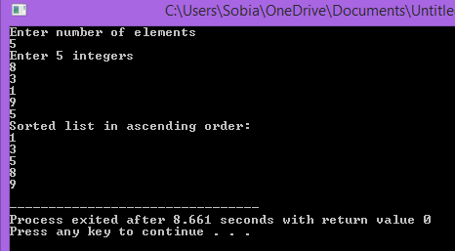
Program
int main() { int array[100], n, c, d, position, t;
printf("Enter number of elements\n"); scanf("%d", &n);
printf("Enter %d integers\n", n);
for (c = 0; c < n; c++) scanf("%d", &array[c]);
for (c = 0; c < (n - 1); c++) { position = c;
for (d = c + 1; d < n; d++) { if (array[position] > array[d]) position = d; } if (position != c) { t = array[c]; array[c] = array[position]; array[position] = t; } }
printf("Sorted list in ascending order:\n");
for (c = 0; c < n; c++) printf("%d\n", array[c]);
return 0; }

Slide 33
Sorting Arrays
Sorting data
Important computing application
Virtually every organization must sort some data
Bubble sort (sinking sort)
Several passes through the array
Successive pairs of elements are compared
If increasing order (or identical ), no change
If decreasing order, elements exchanged
Repeat
Example:
original: 3 4 2 6 7
pass 1: 3 2 4 6 7
pass 2: 2 3 4 6 7
Small elements "bubble" to the top

Slide 34
Bubble-sort

Slide 35
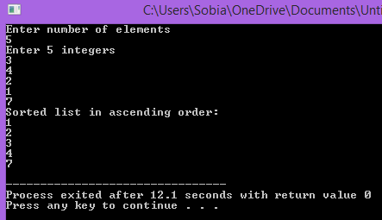
Program
int main()
{
int array[100], n, c, d, swap;
printf("Enter number of elements\n");
scanf("%d", &n);
printf("Enter %d integers\n", n);
for (c = 0; c < n; c++)
scanf("%d", &array[c]);
for (c = 0 ; c < n - 1; c++)
{
for (d = 0 ; d < n - c - 1; d++)
{
if (array[d] > array[d+1]) /* For decreasing order use '<' instead of '>' */
{
swap = array[d];
array[d] = array[d+1];
array[d+1] = swap;
}
}
}
printf("Sorted list in ascending order:\n");
for (c = 0; c < n; c++)
printf("%d\n", array[c]);
return 0;
}

Slide 36
Searching Arrays: Linear Searching
Search an array for a key value
Linear search
Simple
Compare each element of array with key value
Useful for small and unsorted arrays

Slide 37
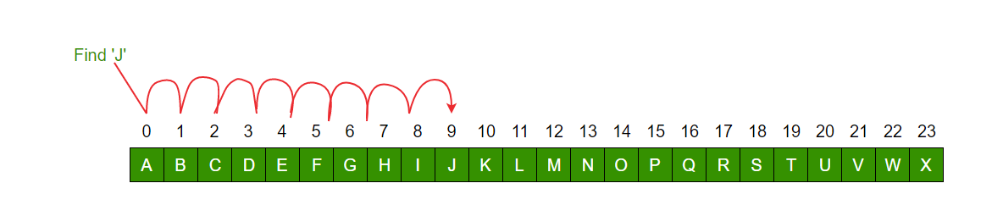

Slide 38
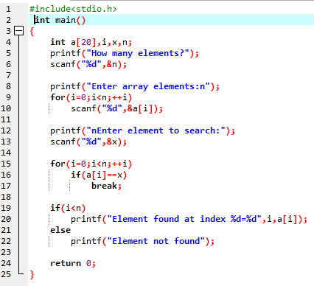
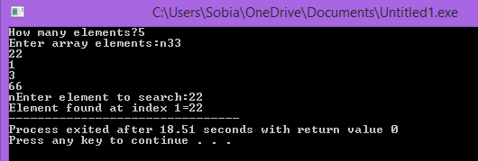

Slide 39
Searching Arrays:Binary Searching
Binary search
For sorted arrays
Compares middle element with key
If equal, match found
If key < middle, looks in first half of array
If key > middle, looks in last half
Repeat
Very fast; at most n steps, where 2^{n} > number of elements
30 element array takes at most 5 steps
2⁵ > 30 so at most 5 steps

Slide 40
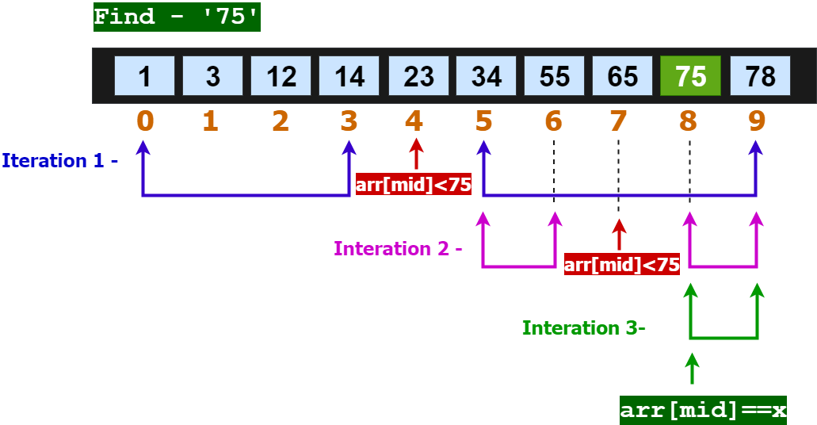
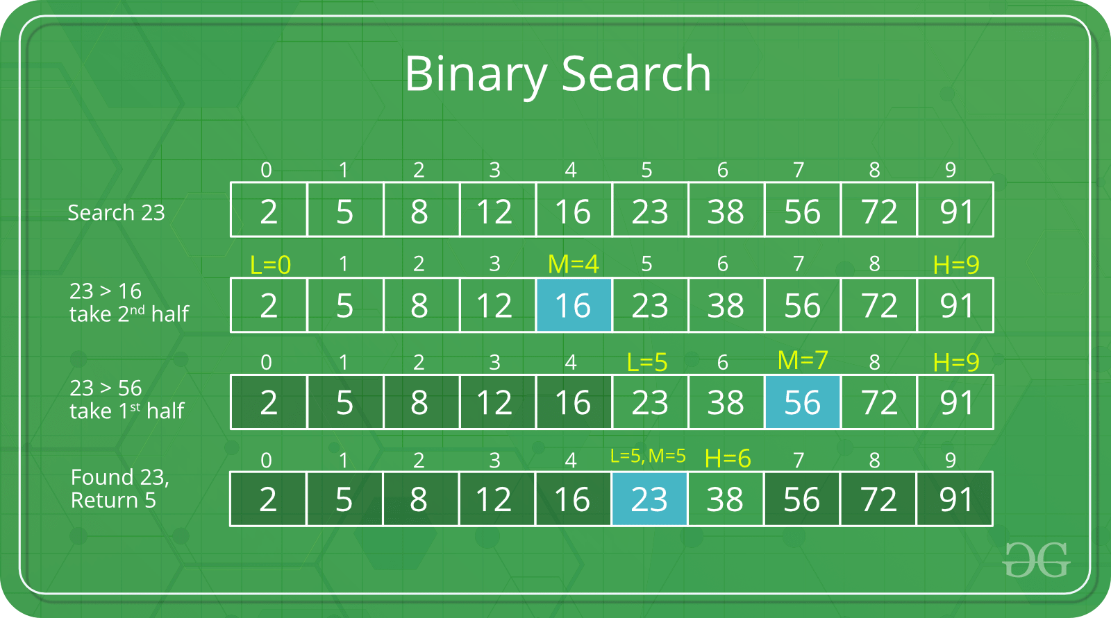
https://prepinsta.com/c-program/binary-search/

Slide 41
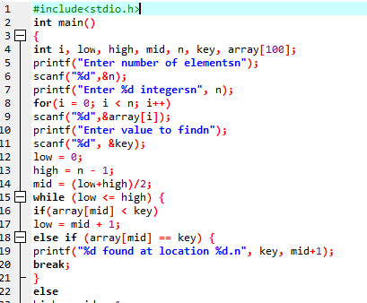
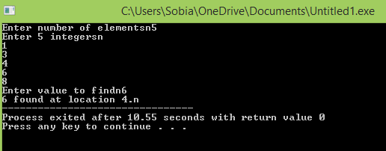
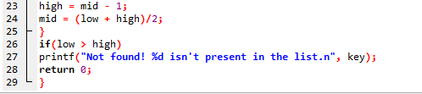

Slide 42
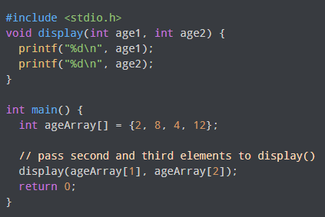
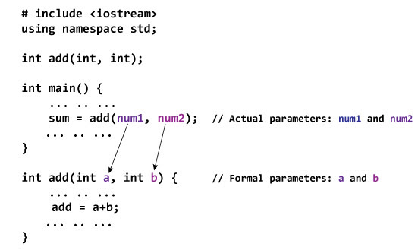
Passing the array as Argument in functions

Slide 43
#include <stdio.h>
float calculateSum(float num[]);
int main() {
float result, num[] = {23.4, 55, 22.6, 3, 40.5, 18};
// num array is passed to calculateSum()
result = calculateSum(num);
printf("Result = %.2f", result);
return 0;
}
float calculateSum(float num[]) {
float sum = 0.0;
for (int i = 0; i < 6; ++i) {
sum += num[i];
}
return sum;
}

Slide 44
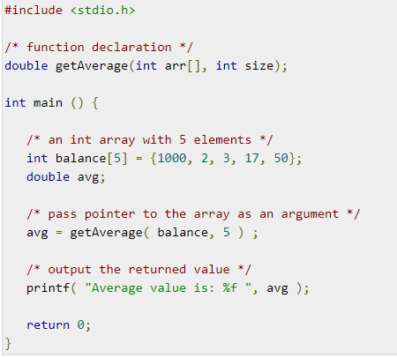
Passing the array as Argument in functions

Slide 45
#include <stdio.h>
void displayNumbers(int num[2][2]);
int main() {
int num[2][2];
printf("Enter 4 numbers:\n");
for (int i = 0; i < 2; ++i) {
for (int j = 0; j < 2; ++j) {
scanf("%d", &num[i][j]);
}
}
// pass multi-dimensional array to a function
displayNumbers(num);
return 0;
}
void displayNumbers(int num[2][2]) {
printf("Displaying:\n");
for (int i = 0; i < 2; ++i) {
for (int j = 0; j < 2; ++j) {
printf("%d\n", num[i][j]);
}
}
}

Slide 46
Thankyou

